Slide 1
“OPTIMAL SPARE PARTS ALLOCATION FOR COMPLEX MILITARY SYSTEMS SUBJECT TO PERFORMANCE AND BUDGET CONSTRAINTS USING MONTE CARLO SIMULATION”
ORSIS 2012
Stas Khoroshevsky
Senior OR Analyst at A.D.Achlama Ltd.
stas@ad-achlama.com

Slide 2

Table of Contents
Introduction
Problem Formulation
Optimization Techniques
  METRIC
  Genetic Algorithms
Hybrid Marginal Method
Numerical Example
Summary & Conclusions

Slide 3
Introduction
For many industrial and defense organizations, systems availability is one of the major concerns and spares provisioning plays an important role to ensure the desired availability.
As the availability is almost always an increasing function of spare parts it is possible to achieve higher availability by allocating more spares. This, however, means more spares provisioning and holding costs, storage space, etc.
Therefore, for large, multi-component systems like aircrafts or industrial production plants the decision of how many spares to keep in each storage is a matter of great signiﬁcance with substantial impact on the system life cycle cost. [Kumar & Knezevic, 1998]

Slide 4
Introduction (Cont’d)
A considerable effort was done in the past to address the problem of determining the optimal spare parts mix using classical optimization methods like gradient methods, dynamic, integer, mixed integer and non-linear programming [Kumar & Knezevic, 1997-98; Messinger & Shooman 1970; Burton&Howard 1971].
Other methods define and utilize various “METRIC” models and their extensions based on the concept of the expected backorder (EBO) [Sherbrooke, Slay, Graves et al].
Unfortunately, such techniques typically entail the use of simpliﬁed models involving numerous analytic approximations of the system performance, while the complexity of modern systems require a realistic model.
Such models involve complex logical relations between components, aging and interactions which require the use of the Monte Carlo method [‎Dubi et al.]

Slide 5
Introduction (Cont’d)
Although the Monte Carlo method enables realistic and reliable models analysis, it may not be suitable for performing optimization, since in order to find the optimal spare allocation a single Monte Carlo simulation should be performed for each of the potential allocation alternatives, which form a huge search space even in simple cases.
This search space forces one to resort to a method capable of finding a near-optimal solution by efficiently spanning the search space and thus other works propose coupling the Monte Carlo method with various meta-heuristic optimization techniques, mainly Genetic Algorithms (GA) [‎Zio et al.]

Slide 6
Introduction (Cont’d)
These methods can be useful in medium scale applications to obtain “near optimum” solutions at reasonable computational effort. However the coupled approach is not feasible for large scale applications because it can require a large number of Monte Carlo simulations.
To overcome the above difficulty a hybrid Monte Carlo optimization method with analytic interpolation was proposed by ‎Dubi, 2000-2003. This method significantly reduces the required number of Monte Carlo calculations by using an analytic approximation for the surface of performance as function of spare parts allocation.

Slide 7
Problem Formulation
The logistic envelope is a set of resources and support functions that maintain the system’s and support its operation. This involves in general the spare parts storages for replacement of failed components, repair teams, repair facilities, diagnostic equipment etc.

Slide 8

Problem Formulation (Cont’d)
We seek a set of resources that will guarantee that the system performance exceeds a threshold value at the smallest possible cost of all resources :
Which is an integer programming problem with nonlinear constraints.

Slide 9


Brief Overview of Optimization Methods
METRIC
Genetic Algorithms

Slide 10
METRIC

Slide 11
METRIC
Multi-Echelon Technique for Recoverable Item Control
This method [‎Sherbooke et al.] is based on the concept of the EBO (expected backorder) – the number of demands for spares for which there is no spare available to support the demand.
Assuming that the rate of spares demand is given by a Poisson distribution, the EBO can be expressed as:
where is the probability of demands (failures) which is assumed to be Poisson distribution with an average “pipeline”

Slide 12
METRIC (Cont’d)
Assuming N identical serial systems in the field and QPAi components of type i in each system, the probability that all the components of this type are operational is given in METRIC by:
Since the system structure is serial, i.e. the system is assumed to be failed when it has at least one “hole”, and assuming that all types are independent, the availability of a system could be expressed as:

Slide 13
METRIC (Cont’d)
It was shown previously that is a decreasing and a convex function of the spare parts (discrete convexity).
At every step we compare the relative increment in the availability per unit cost, namely:
A single spare is added to the component type for which is maximal.
It can be shown that if and only if the system availability is an additive convex function this will lead to an optimum providing the highest availability at a minimal spare parts cost.

Slide 14


METRIC Summary
Pros
  Simplicity
Cons
  Purely analytical model for the estimation of system performance
  Numerous assumptions and approximations
  Optimal results only in case of serial system

Slide 15
Genetic Algorithms

Slide 16

Genetic Algorithms
Heuristic search and optimization methods are widely spread and used in many fields of science. The basic premise of these methods is that at every step of the process an improvement of the target function is obtained, although there is no proof that the final result is indeed optimal.
Genetic Algorithms (GA) are is one of the most widely used heuristics and is found in many applications including the realm of system engineering and reliability [‎Zio et al.] The GA’s are inspired by the “optimization” procedure that exists in nature, namely, the biological phenomenon of evolution.
It maintains a population of different solutions and uses the principle of "survival of the ﬁttest" to “drive” the population towards better solutions.

Slide 17
Genetic Algorithms (Cont’d)
The canonical structure of the typical GA flow :

Slide 18
Genetic Algorithms (Cont’d)
Implementation
  Specie
  Fitness
  Probabilistic process of Selection, Crossover and Mutation
  Termination criteria – number of generations

Slide 19
Genetic Algorithms Summary
Pros
  Do not require any information about the objective function besides its values corresponding to the points considered in the solution space
  Provides “near-optimal” solutions in non-convex cases
Cons
  Involves large number of parameters that are chosen arbitrarily
  Requires excessive computational effort since the fitness function has to be evaluated using MC method for each candidate solution
  Optimality of the solution is not guaranteed

Slide 20

Hybrid Marginal Method

Slide 21
Hybrid Marginal Method
The Hybrid Marginal approach was specifically developed to optimize models based on the use of the Monte Carlo method [Dubi 2000-2003].
This approach significantly reduces the required number of Monte Carlo calculations by using an analytic approximation for the surface of performance as function of spare parts allocation.
The parameters involved in this function are “learned” from the Monte Carlo calculation and are controlled and updated using a small number of MC calculations along the optimization procedure.

Slide 22
Hybrid Marginal Method (Cont’d)
The coupling of Hybrid Marginal approach with Monte Carlo models requires a representation of system performance as function of the operation rules and the spare parts allocation.
It is essential to have an analytic approximation for the dependence of the availability, production or any other performance measure as function of the model parameters.

Slide 23
Hybrid Marginal Method (Cont’d)
Looking for such approximation a few principles should be noted:
Since the system performance is a problem dependent complex function that requires a MC model, there is no known way to represent it in a general rigorous analytic form. Thus the expression has to be a semi heuristic form that captures the main impact of adding spares of each type on the system performance
The only effect a limited number of spares has on the components is in increasing the waiting time for a spare, hence increasing the total repair time of type and the “lack of performance” (unavailability, or loss of production) is a decreasing function of the waiting time

Slide 24
Hybrid Marginal Method (Cont’d)
The expression must be simple enough to allow optimization through search methods such as marginal analysis or any local search
Another important point to note is that we assume that the optimum is not a sharp "hole" such that adding or removing a single spare may lead critically off the optimum. It is in fact a rather wide “valley” were a large number of spares allocations yield similar results.
This is a conclusion drawn from many optimization studies done on realistic industrial problems. We, therefore, seek a semi-heuristic function to lead into a result within that range.

Slide 25
Hybrid Marginal Method (Cont’d)
The first task is to present the system’s performance in terms of the contribution of the separate types of components and it is done using a sensitivity concept.
We define the sensitivity of a component type as an additional measure of importance in causing system downtime. The sensitivity is calculated within the MC simulation by considering at each system failure the component types responsible for that failure.
A component is considered "responsible" if it fulfils two conditions: it is failed at the time of system failure and its ad-hoc repair repairs the system.

Slide 26
Hybrid Marginal Method (Cont’d)
The down time of the system upon this failure is assigned to all the types found responsible for the failure and accumulated during the simulation.
The sensitivity is defined as the ratio of the average downtime associate with this type to the total downtime, namely:
Where is representative of the total downtime of the system (not exact of course and would be exact only if all failures are caused by a single type at a time) and is a measure of the contribution of each type to that downtime time.

Slide 27
Hybrid Marginal Method (Cont’d)
We define the partial unavailability contributed by type i as
Obviously this value is normalized, since
To introduce a semi heuristic dependence on the waiting time one would think first on a linear dependence.
Furthermore, the steady state unavailability is given as:
Assuming that the steady state unavailability is approximately a linear function of the waiting time.

Slide 28
Hybrid Marginal Method (Cont’d)
This yields the following approximation for the system unavailability (Tw approximation)
Where the average waiting time for a spare is given by:
(obtained under the assumption of a constant flow of demands for spare and an exponential distribution of the time between consecutive demands)

Slide 29
Hybrid Marginal Method (Cont’d)
– are constants referred to as the bulk parameters of the problem.
Although depends on the spare parts allocation of other component types, we assume that it is a slow changing function over a range of spare parts, thus can be assumed as a constant for a range of spares, and being updated as spares are added after each Monte Carlo calculations.
The optimization process starts with two Monte Carlo calculations, one with zero spares (mode 2) and one with a “sufficient” amount of spares (mode 1/∞), then the partial unavailability's are calculated for each component type and this yields the set of bulk parameters.

Slide 30
Hybrid Marginal Method (Cont’d)
Once these two calculations are performed and the sensitivity of each type is obtained we find the bulk parameters using
The bulk parameters are obtained in the process of solving these equations thus:

Slide 31
Hybrid Marginal Method (Cont’d)
Once the parameters are calculated, spares are added in order to reduce the unavailability and a marginal analysis is conducted. At each step of the marginal analysis the most "cost effective" type of spare is determined and a single spare is added to its stock.
After a number of analytic steps a Monte Carlo calculation is done with the current allocation. The equations that are obtained from that calculation replace the (Mode 2) initial equations and is recalculated. The process continues until the target performance (availability) is achieved.

Slide 32
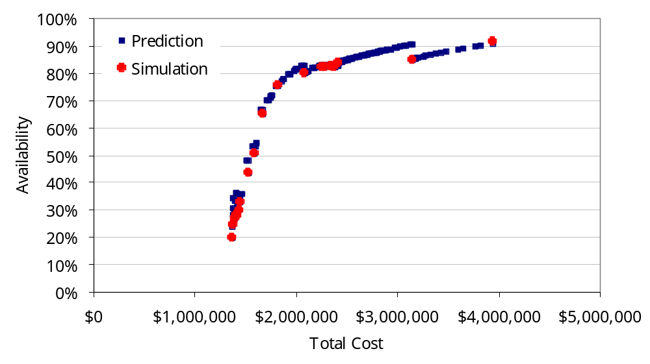
Hybrid Marginal Method (Cont’d)

Slide 33
Hybrid Marginal Method Summary
Pros
  Relatively easy to implement
  Enables correct assessment of system performance
Cons
  Depends on the correctness of the Waiting Time Approximation
  Utilizes a greedy heuristic technique for the optimization purposes and thus provides optimal solutions only if the system performance function is convex on its domain (spare parts)

Slide 34
Numerical Example
All systems, data and logic appearing in this example are fictitious.
Any resemblance to real systems and names, is purely coincidental.

Slide 35
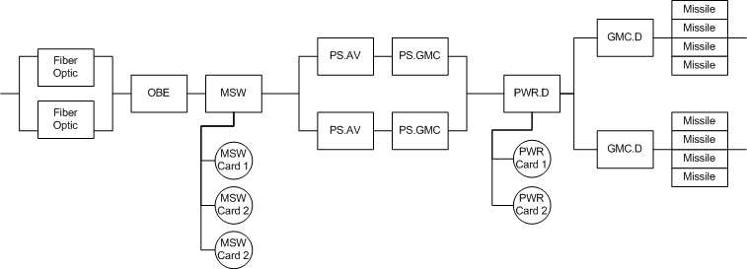
Air Defense System Launcher
Launcher RBD
Multi-Indenture structure: LRUs/SRUs

Slide 36

Logistic Envelope
The launchers are located at 2 different bases (O-Level)
  Base 1: 2 Launchers
  Base 2: 1 Launcher
O-Level Bases are supported by a single Intermediate Maintenance Level which is supported by the manufacturer’s depot
1 Launcher
Base #2
I-Level
Depot
D-Level
Depot
2 Launchers
Base #1

Slide 37
Logistic Data
LRU | SRU | Cost | MTBF | MTTR | TSHIP | TAT
Fiber Optic |  | 2,000$ | 300,000 | 4 | Discarded
OBE |  | 35,000$ | 11,000 | 1.5 | 7d | 60d
MSW |  | 15,000$ | - | 2 | 7d | 45d
 | MSW Card 1 | 2,500$ | 7,000 | - | - | 60d
 | MSW Card 2 | 3,400$ | 2,500 | - | - | 90d
 | MSW Card 3 | 6,200$ | 5,000 | - | - | 120d
PS.AV |  | 12,000$ | 10,000 | 2 | 7d | 45d
PS.GMC |  | 15,000$ | 9,000 | 1 | 7d | 45d
PWR.D |  | 110,000$ |  | 1 | 7d | 45d
 | PWR Card 1 | 15,000$ | 4,000 | - | - | 30d
 | PWR Card 2 | 35,000$ | 16,000 | - | - | 60d
GMC.D |  | 120,000$ | 20,000 | 2.5 | 7d | 60d
Missile |  | 300,000$ | 10,000 | 1.5 | Discarded

Slide 38
Rules of Operation
95% BIT Efficiency on each LRU
BIT automatically initiated once in 24 hours on each system
No false positive alarms
Failed component is removed and sent for repair/discarded, then the search for spare part is conducted in the local storage of each base

Slide 39
Mission Profile
From | To | Profile
0 - | 5000 | Peace
5000 - | 5504 | Surge
5504 - | 7000 | Peace
7000 - | 7336 | Surge
7336 - | 7662 | War
7662 - | 8760 | Peace
Mission Time : 1 yr = 8760 hr
Peace Profile
  Negligible activity
Surge Profile
  Low frequency rocket launches
War Profile
  High frequency rocket launches

Slide 40
Operational Constraints
Initial Stock
LRU | SRU | Base 1 | Base 2 | I-Level Depot
Fiber Optic |  | 1 | 1
OBE |  | 1 | 1
MSW |  | 1 | 1
 | MSW Card 1 |  |  | 2
 | MSW Card 2 |  |  | 3
 | MSW Card 3 |  |  | 2
PS.AV |  | 1 | 1
PS.GMC |  | 1 | 1
PWR.D |  | 1 | 1
 | PWR Card 1 |  |  | 2
 | PWR Card 2 |  |  | 2
GMC.D |  | 1 | 1
Missile |  | 20 (70) | 20 (70) | 100

Slide 41
Software
“Annabelle” Software developed by A.D. Achlama allows us to model
  Complex structural relations within the system
  Any number of operational (Fields) and maintenance (Depots) locations
  Operational logic with any degree of complexity
  etc

Slide 42
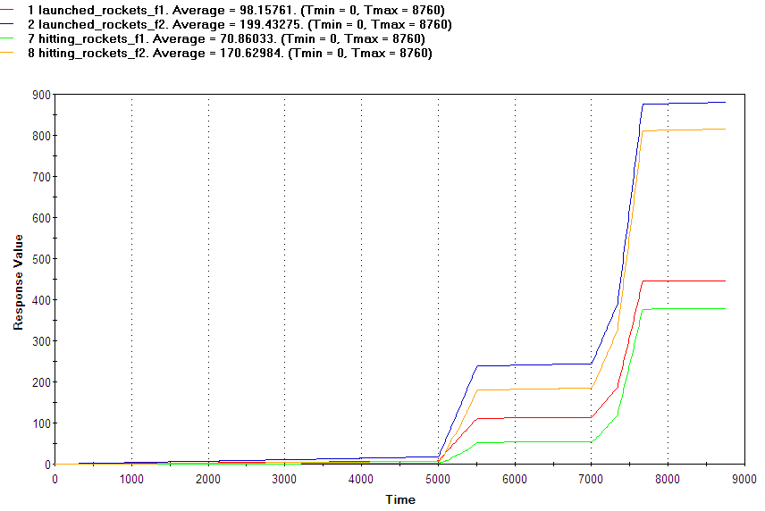
Initial Performance
Launched vs. Hitting

Slide 43
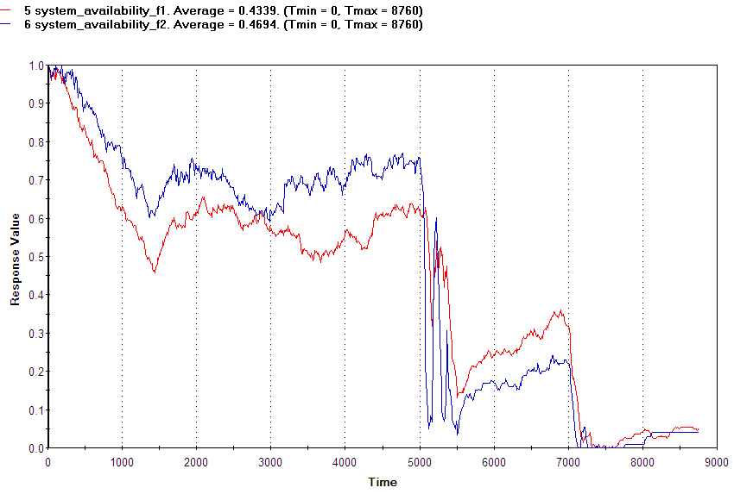
Initial Performance
System Availability

Slide 44
Upper and lower bounds of System Performance
Availability vs. Efficiency

Slide 45
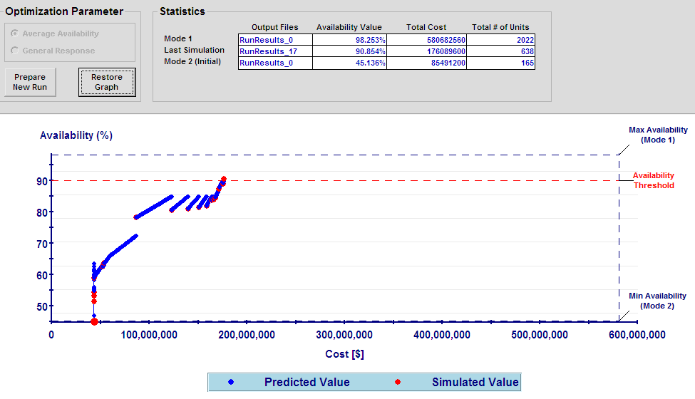
Optimization

Slide 46
Optimization
Optimal stock
LRU | SRU | Base 1 | Base 2 | I-Level Depot
Fiber Optic |  | 1 | 1
OBE |  | 3 | 2 | 2
MSW |  | 4 | 3 | 5
 | MSW Card 1 | 2 | 1 | 2
 | MSW Card 2 | 3 | 2 | 1
 | MSW Card 3 | 2 | 2 | 3
PS.AV |  | 2 | 1 | 2
PS.GMC |  | 70 | 20 | 490
PWR.D |  |  |  | 2
 | PWR Card 1 |  |  | 5
 | PWR Card 2 |  |  | 3
GMC.D |  |  |  | 2
Missile |  |  |  | 2
Average Availability :
90.85%
Total Cost :
176,089,600

Slide 47
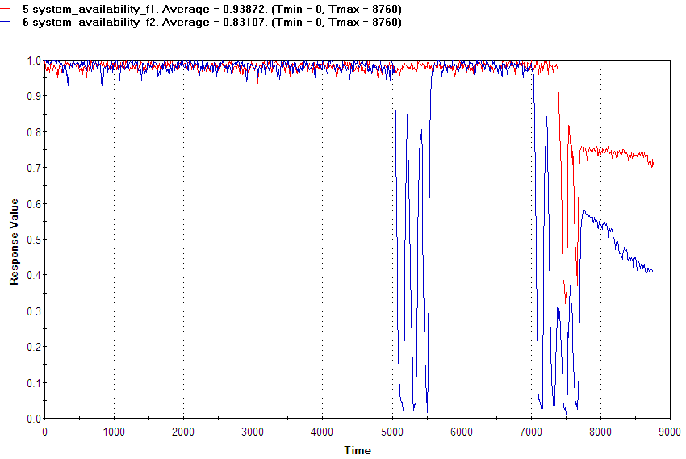
Results (Optimal Stock)

Slide 48
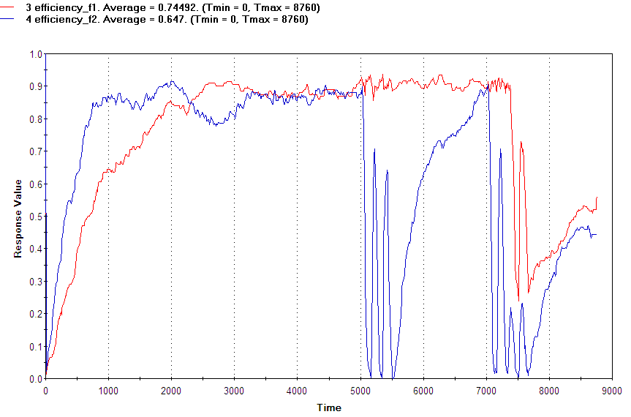
Results (Optimal Stock)

Slide 49
Summary & Conclusions
The presented method has a number of advantages. It is simple and practical as it requires a small number of Monte Carlo calculations which is a key consideration in Monte Carlo based optimization processes.
Still, the method depends on the accuracy of the waiting time approximation for the analytic dependence of the target performance function on the spare parts and possibly other logistics parameters.
Effort will be directed in the future to improve this approximation, although the method is secured in the sense that it is impossible to reach wrong conclusions because eventually a Monte Carlo calculation is confirming the actual system’s performance.

Slide 50
Questions?
Thank You!

Slide 51
References
D.Kumar, J.Knezevic. Availability based spare optimization using renewal process. Reliability Engineering and System Safety 59, pp 217-223, 1998
D.Kumar, J.Knezevic. Spares optimization models for series and parallel structures. Journal of Quality in Maintenance Engineering 3(3), pp 177-188, 1997
M.Messinger, M.L.Shooman. Techniques for optimal spares allocation a tutorial review. IEEE Transactions on Reliability 19, pp 156-166, 1970
B.M.Burton, G.T.Howard. Optimal design for system reliability and maintainability. IEEE Transactions on Reliability 20, pp 56-60, 1971
C.Sherbrooke. Optimal Inventory Modeling of Systems. 2nd Ed., Kluwer, 2004
Miller, B.L. Dispatching from Depot Repair in a Recoverable Item Inventory System: On the Optimality of a Heuristic Rule. Management Science, Vol. 21, No.3, 1974, pp 316-325.
Slay F.M. VARI-METRIC: An Approach to Modeling Multi-Echelon Resupply when Demand Process is Poisson with a Gamma Prior. LMI, Report AF301-3, 1984.
Sherbrooke, C.C. Improved Approximations for Multi Indenture, Multi Echelon Availability Models. LMI, Working Note AF301-1, 1983.
Graves, S.C. A Multi-Echelon Inventory Model for a Low Demand Reparable Item. Sloan School of Management, M.I.T., WP-1299-82, 1982.
Graves, S.C. A Multi-Echelon Inventory Model for Repairable Item with One for One Replenishment. Management Science, Vol. 31, 1985, pp. 1247-1256.
Sherbrooke, C.C. An Evaluator for the number of Operational Ready Aircraft in a Multi-level Supply system. Operations Research Vol.19,1971,pp.618-635
Muckstadt, J.A. A Multi Echelon Model for Indentured Consumable items. TR-548, School of Operations Research, Cornell University, Ithaca, New York. 1982
Wong H., Kranenburg B., van Houtum G.J., Cattrysse D. Efficient heuristics for two-echelon spare parts inventory systems with an aggregate mean waiting time constraint per local warehouse. OR Spectrum Vol 29.4, pp 699-672, 2007
E.Zio, M.Marseguerra, L.Podolfini. Multiobjective spare part allocation by means of genetic algorithms. Reliability Engineering and System Safety 87, pp 325-335, 2005
X.Zou. Availability based spare optimization using genetic algorithms. IEEE Transactions on Reliability, pp 4599-4601, 2007
Lee L.H, Chew E.P, Tenga S., Chen Y. Multi-objective simulation-based evolutionary algorithm for an aircraft spare parts allocation problem. European Journal of Operational Research, Vol. 189.2, 2008, pp 476-491

Slide 52
References (Cont’d)
A. Dubi. Maintenance Resources Modeling and Optimization Analytic aspects and Monte Carlo applications. CNIM; Italian National committee for Maintenance, MM2007, Rome pp 1-12.
A.Dubi. The Monte Carlo Method and Optimization of Spare parts in complex Realistic scenarios. Proc. RAMS Symposium, Newport Beach, California, 2006
A.Dubi. Predictive Modeling and Simulation for Maximizing system performance. JMO INK publishing, London, Ontario Canada 2006, pp 1-482.
A. Dubi. Monte Carlo Applications In System Engineering. J.Wiley & Sons UK, Chichister, 2000, pp 1 -276
A. Dubi. System Engineering Science – Analytic principles and Monte Carlo Methods. Mirce Science Publ. Dec. 2003, pp 1-166
M.Khazen, A. Dubi. A Note on Variance Reduction methods in Monte Carlo applications to System Engineering and Reliability. Monte Carlo Methods & Applications, Vol. 5, No. 4, pp 345-374, 1999 ISSN 0929-9629.
S. Kirkpatrick, C. D. Gelatt, M. P. Vecchi. Optimization by simulated annealing. Science, 20(4598):671–680, 1983
V. Cerny. A thermodynamical approach to the traveling salesman problem: An efficient simulation algorithm. Journal of Optimization Theory and Applications", 45:41-51, 1985
N. Metropolis, A. Rosenbluth, M. Rosenbluth, A. Teller, and E. Teller. Equation of state calculations by fast computing machines. Journal of Chemical Physics, 21:1087–1092,1953.
E-G. Talbi. Metaheuristics. From design to implementation. Wiley, 2009
H. Everett. Generalized Lagrange Multiplier Method for Solving Problems of Optimum Allocation of Resources. Operation Research Vol. 11, No. 3, May-June 1963, pp. 399-417
E.A. Silver. Inventory allocation among an assembly and its repairable subassemblies. Naval Research Logistics Quarterly 19 (2) (1972) 261–280.
E.V. Denardo. Dynamic Programming: Models and Applications. Dover Publications, 2003
Xiancun N., Hongfu Z., Ming L. Research on optimization model of civil aircraft spare parts inventory allocation. Control and Decision Conference, 2008, pp. 1042 – 1045
A.Dubi. Maintenance Resources Modeling and Optimization: Analytic Aspects and Monte Carlo Applications, Proceedings of MM2007, CNIM, pp. 1-12
A.Dubi. Modeling of Realistic Systems with the Monte Carlo Method – A Unified System Engineering Approach, Annual Reliability and Maintainability Symposium, Jan 2002, USA, pp.1-23

Slide 53
References (Cont’d)
A.Dubi. Pebble Bed Modular Reactor Plant Power Production RAM Status Report, Exigent Engineering Proprietary Report, Sep 2008, pp. 1-33
A.Dubi, A. Gruber. Report on RCL project. Presentation, optimization and approach to calculation, DAU Proprietary Report, 2003, pp. 1-34
A.Dubi. Logistic optimization with Monte Carlo based Models, OR52, Sep 2010, Keynote Paper, pp. 3-17
E.Hassid. Spares Parts Inventory Planning Transition from Local/Item Approach to Centralized/System Approach while Utilizing SPAROptTM Hybrid Platform. Proceedings of the Industrial Engineering and Management Conference'08, Tel Aviv, Mar 2008, pp. 1-7
Gurvitz N., Borodetsky S., van Eck P. ATLAST deployment & push pack spares optimization module. Reliability and Maintainability Symposium, 2005. Proceedings. Annual Jan. 24-27, 2005, pp. 55-60
Bronfenmakher V., Spare Parts and Maintenance Optimization for Multi-Field Multi-Echelon Models in System Engineering, M.Sc Thesis supervised by: Prof. Dubi A., Ben-Gurion University of Negev 2008, pp 1-92.
Goldfeld A., Dubi, A., SPAR – A general purpose Monte-Carlo System Analysis Code, MCP Report & Manual, 1995, Malchi Science Publications

